Slide 1
www.ilpathways.com
Using Labor Market Information to Analyze Programs of Study and Career Clusters
February 22, 2013

Slide 2
Using Labor Market Information to Analyze Programs of Study and Career Clusters
 | Jason Tyszko, Deputy Chief of Staff Jason.Tyszko@illinois.gov.
 | Mitch Daniels, Assistant Division Manager of the Economic Information and Analysis Division Mitch.Daniels@Illinois.gov

Slide 3
Improves P-20 education, workforce, and economic development coordination in order to build more effective STEM talent pipelines.
Supports implementation of college and career readiness standards and assessments.
Provides a strategy to meet the goal of 60 percent of adults attaining a high-quality academic degree or industry credential by 2025.

Slide 4
Supports programs that empower students to explore their academic and career interests in STEM fields.
Supports local programs through the launch of new statewide, public-private partnerships known as STEM Learning Exchanges.

Slide 5
Labor market information plays an important role in identifying priority STEM programs for your learners and your community.
While labor market information is an important factor in selecting STEM career clusters and pathways, it is only one of many considerations that should be taken into account. Connections should be made to…
Community colleges and postsecondary partners;
Local chambers of commerce and business associations;
Community organizations; and
STEM Learning Exchanges.

Slide 6
Objective: Establish a Labor Market Review Process
Use the Illinois Pathways website.
Understand your regional economy.
Identify critical occupations within selected industries.
Locate and connect to local employers/partners.
Identify additional useful resources: - Help Wanted OnLine - Local Labor Market Economists
Assemble the data to be useful.

Slide 7
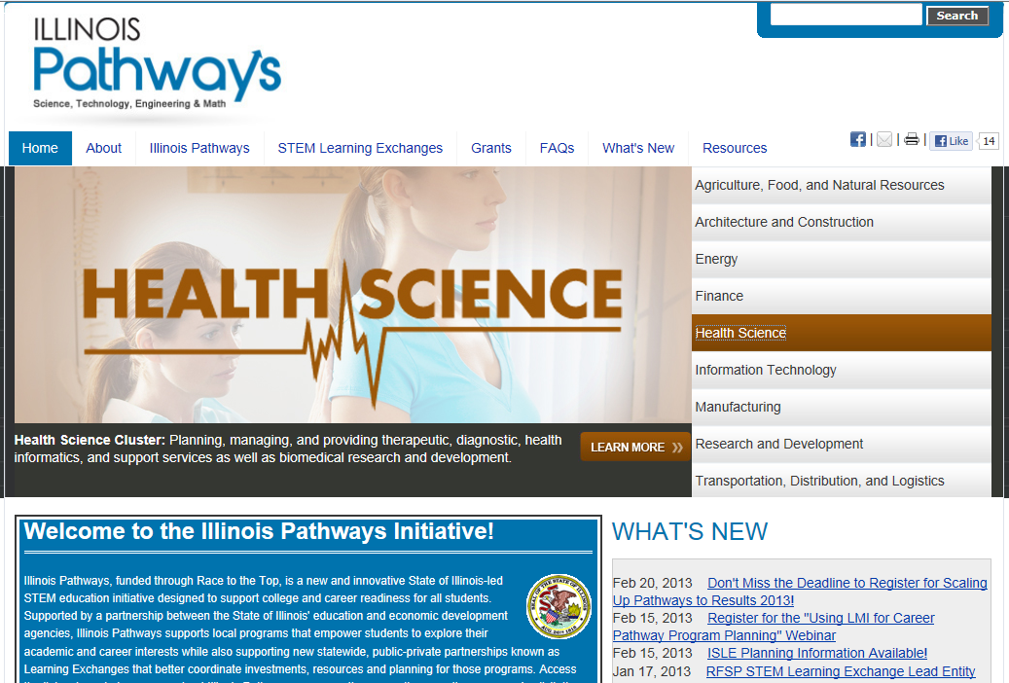
Illinois Pathways http://www.ilpathways.com
Read background information and download flyers.
See the framework for each of the Illinois Pathways and related careers/labor market information.
Connect to STEM Learning Exchanges.
Learn about grants.
Ask questions and see answers.
Subscribe to receive the latest updates.
View and download resources and research.
1
2
3
4
5
6
7

Slide 9
IDES and Illinois Pathways Websites
Key sources of state, regional, and local:
career clusters > pathways > critical occupations ≈ growing, “in-demand” careers
industry and occupational employment projections
occupational wage data
supply-demand analysis
postsecondary training programs
additional resources.
http://www.ides.illinois.gov/lmi
http://www.ilpathways.com

Slide 10
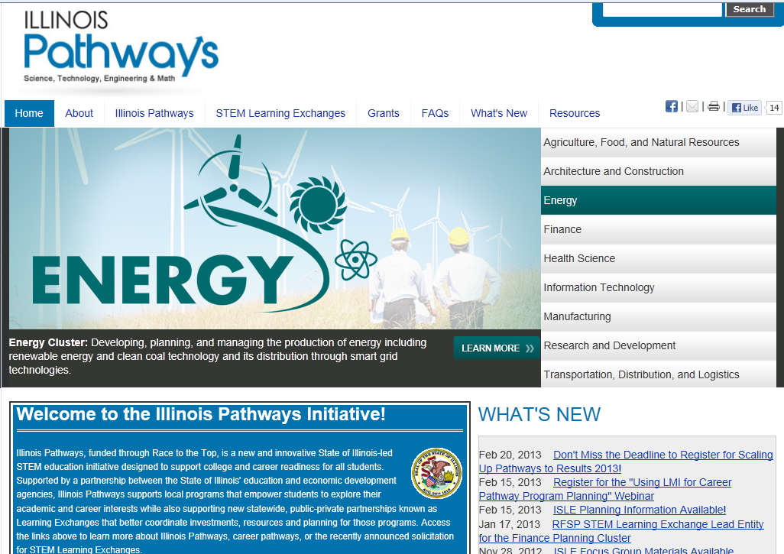
Illinois Pathway Initiative
Framework that leads to growing careers, related LMI and postsecondary training programs offering them, and the current supply and demand of trained workers.

Slide 11
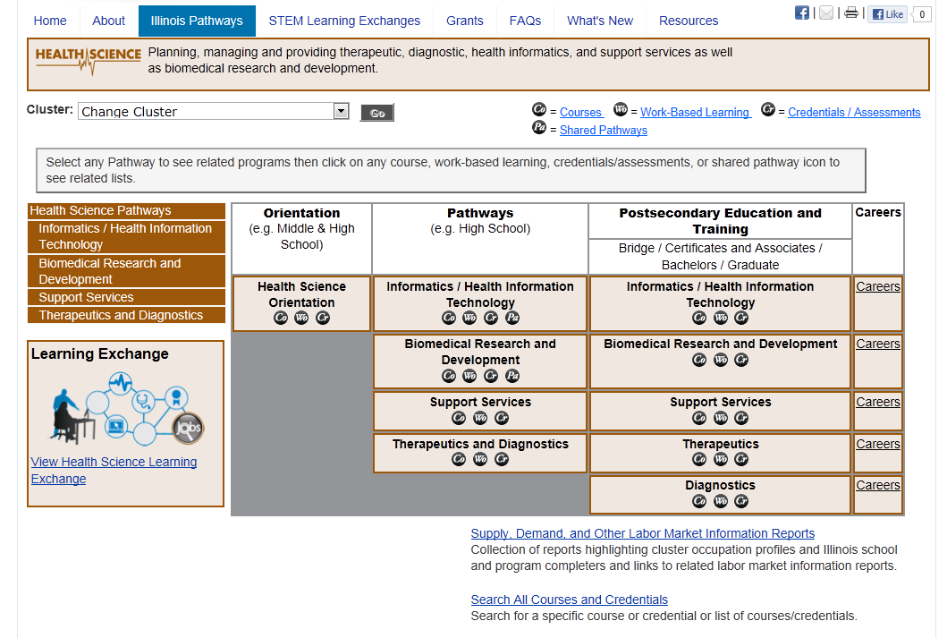
Critical Occupations within Selected Industries/Pathways

Slide 12
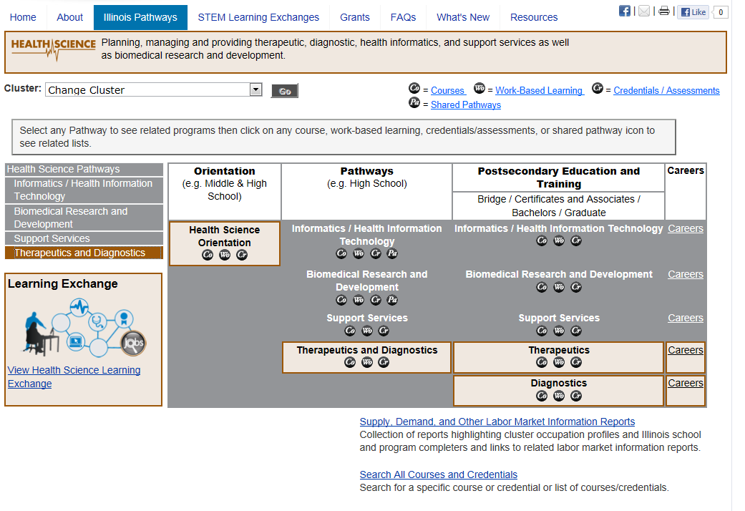
Critical Occupations within Selected Industries/Pathways
Example – Selected Careers for Therapeutics and Diagnostics

Slide 13
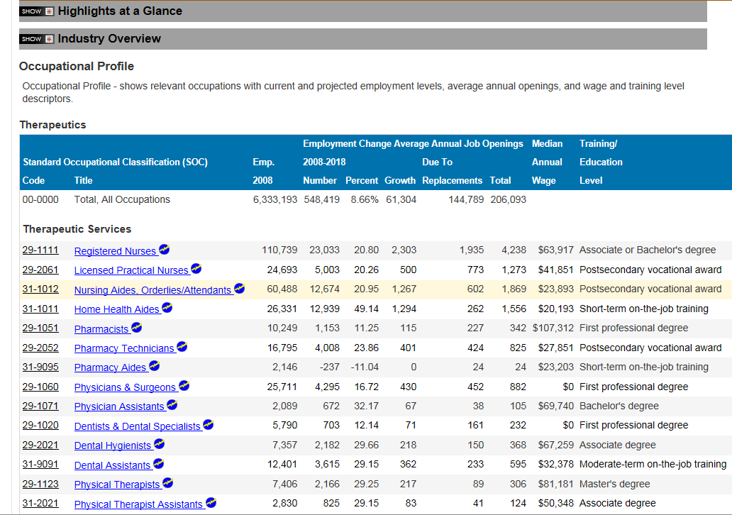
Critical Occupations within Selected Industries/Pathways
Example – Selected Careers for Therapeutics and Diagnostics

Slide 14
Critical Occupations within Selected Industries/Pathways
Example – Registered Nurses
See occupation information
Select to see Employment & Outlook

Slide 15
Critical Occupations within Selected Industries/ Pathways
Example – Registered Nurses
In Illinois, employment of registered nurses is expected to increase much faster than average through 2018. About 4,240 openings are expected annually. Registered nurses is one of the top 50 fastest growing occupations and one of 10 occupations expected to provide the most job openings each year in Illinois.

Slide 16
Critical Occupations within Selected Industries/Pathways
Supply, Demand, and Other Labor Market Information Reports

Slide 17
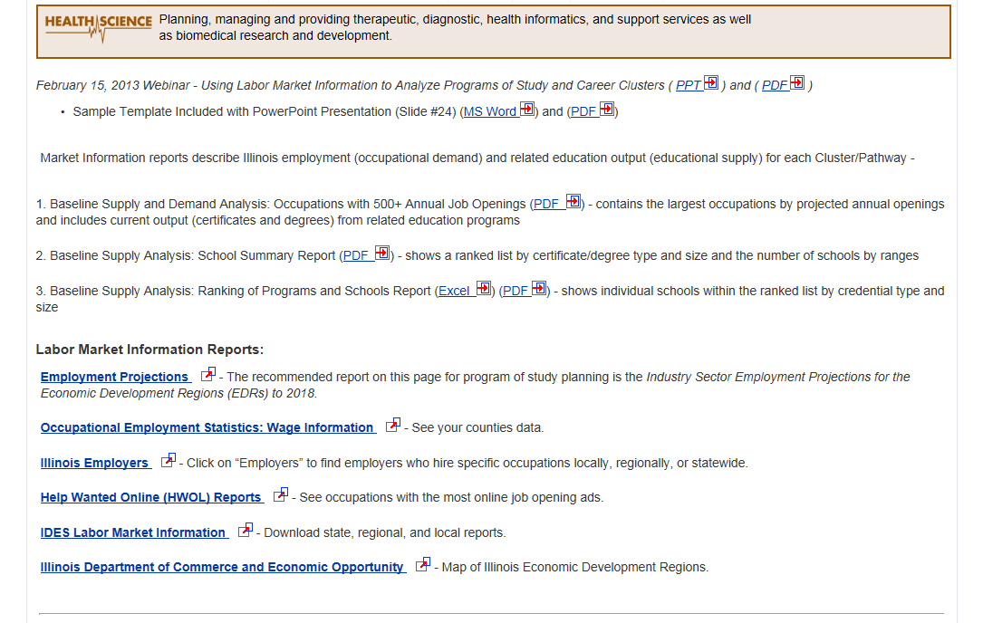
Critical Occupations within Selected Industries/Pathways
Supply and Demand Reports and all of the labor market information in the slides that follow is linked from here.

Slide 18
Makeup of the Regional Economy
Which Industry Super-Sectors / Career Clusters are Critical to the Region/State?
At www.IDES.Illinois.gov under “Workforce Partners” choose “Labor Market Information” or www.IDES.Illinois.gov/LMI.
Select “Employment Projections”.
Access industry or occupational reports for:
Local Workforce Areas
Economic Development Regions (EDRs) - Industry Employment Projections.
The next two slides compare the concentrations of career cluster employment in the Rockford area to the state.

Slide 19
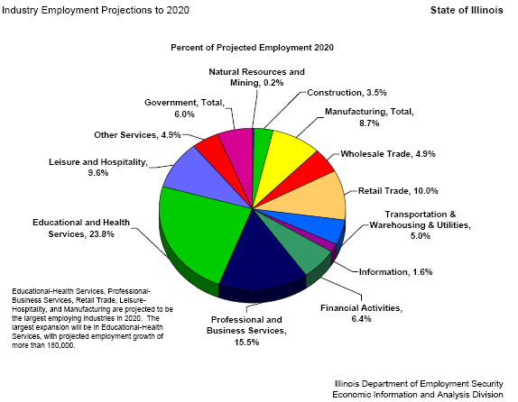
Makeup of the Regional Economy

Slide 20
Makeup of the Regional Economy

Slide 21
Makeup of the Regional Economy
Local Industry Picture
ADAMS COUNTY
 | Number of | Number of | Wages
 | Units | Employed | ($1,000s)
Total | 1,883 | 33,304 | $300,619
Private Sector (NAICS) | 1,787 | 29,113 | $262,791
Natural Resources and Mining | 21 | 294 | $3,030
Construction | 252 | 1,231 | $11,046
Manufacturing | 95 | 5,077 | $61,740
Trade, Transportation, and Utilities | 484 | 7,735 | $55,735
Wholesale Trade (42) | 136 | 1,870 | $17,534
Retail Trade (44,45) | 279 | 4,805 | $26,701
Transportation & Warehousing (48,49) | 65 | 953 | $9,620
Utilities (22) | 4 | 107 | $1,879
Information | 25 | 525 | $4,392
Financial Activities | 168 | 2,275 | $22,485
Professional and Business Services | 225 | 2,183 | $23,939
Professional, Scientific & Technical Services | 131 | 661 | $7,619
Management of Companies & Enterprises (55) | 5 | 82 | $2,303
Administrative & Support & Waste Mngmt. (56) | 89 | 1,440 | $14,017
Educational and Health Services | 139 | 5,589 | $64,021
Educational Services (61) | 19 | 511 | $4,070
Health Care & Social Assistance (62) | 120 | 5,078 | $59,951
Leisure and Hospitality | 169 | 2,980 | $9,351

Slide 22
Identify and Connect to Local Employers/Partners
STEM Learning Exchanges
Learn about and connect using http://www.ilpathways.com.

Slide 23
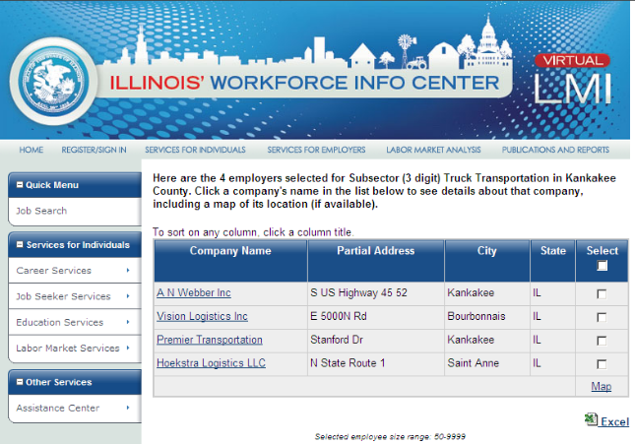
Identify and Connect to Local Employers/Partners
Use Employer Lists from the Illinois Workforce Info Center.
Industry Type
Company name
Number of Employees
Address
Contact Information
https://illinois.virtuallmi.com/
Select “Employers”.

Slide 24
Identify Local Employers/Partners
Example of the employer information from Illinois Workforce Info Center.

Slide 25
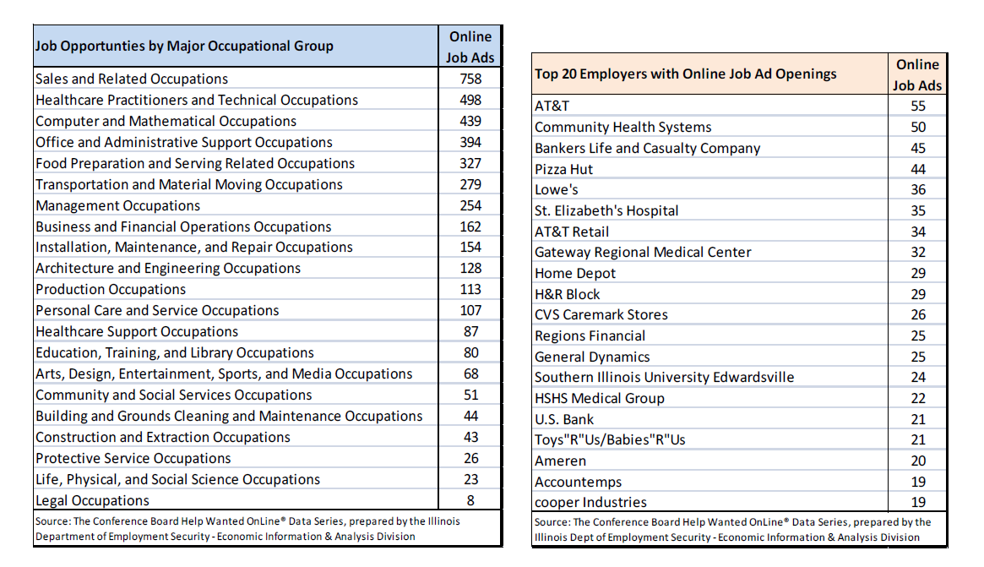
Other Resources
Help Wanted OnLine (HWOL): Captures data about job postings from over 16,000 Internet job boards. Download tables showing most frequent online job ads and employers for Economic Development Regions (EDR).
http://www.IDES.Illinois.gov/LMI
Select “Help Wanted OnLine (HWOL) Reports”.
Example: Economic Development Region #9 Southwestern Illinois / Alton-Belleville Area

Slide 26
Assembling the Data to be Useful
Sample Template: (Area/Region) ___________________
Career Cluster: ______________________ Industry Employment Share of Regional Economy is ___% compared to State at ___%
Career Pathway: ______________________ Number of firms___ Employment _____ Share of Area Wages ___% of total
Career Program of Study: ______________________ * Critical Occupations___ _________ __Employment /Growth/AAJO _____ ______________ Median Annual Wages _$______
* Critical Occupations___ _________ __Employment /Growth/AAJO _____ ______________ Median Annual Wages _$______
Partners/Large Local Employers: (with recent online job ads) _________________________________ ( ) _________________________________ ( ) _________________________________ ( )

Slide 27
Assembling the Data to be Useful
Sample Template: Kane-DeKalb-Kendall Counties Area Career Cluster: Manufacturing (based upon input from local leaders) Industry Employment Share of Regional Economy is 8.3% compared to State at 8.7%
Career Pathway: Automation Number of firms 1,185 Employment 38,337 Share of Area Wages 26.2% of total
Career Program of Study: Maintenance Installation & Repair * Critical Occupations: General Maintenance & Repair Workers Employment /Growth/AAJO 2,532 / 7.1% / 57 Median Annual Wages $39,952
* Critical Occupations: Industrial Machinery Mechanics Employment /Growth/AAJO _484 / 10.5% / 12 Median Annual Wages $48,004
Partners/Large Local Employers: (with recent online job ads) Caterpillar, Inc. [Montgomery] (48) Bison Gear and Engineering [St. Charles] (17) Elgin Industries [South Elgin] (15)

Slide 28
Need Assistance?
IDES Local Labor Market Economists – Can assist with identifying and interpreting LMI and provide customized HWOL reports.
Tom Austin Vicki Niederhofer 3134 11th Street 4519 W. Main Street Rockford, IL 61109 Belleville, IL 62223 (815) 395-6680 (618) 277-5678 x390 Tom.Austin@Illinois.gov Vicki.Niederhofer@Illinois.gov
Dennis Hoffman Ron Payne 333 Potomac Blvd., Suite G 850 East Madison, 3rd Floor Mt. Vernon, IL 62864 Springfield, IL 62702 (618) 242-7879 (217) 557-1869 Dennis.Hoffman@Illinois.gov Ron.Payne@Illinois.gov
Norman Kelewitz 260 East Indian Trail Rd. Aurora, IL 60505 (630) 844-8455 Ext. 276
Norman.Kelewitz@Illinois.gov

Slide 29
Resources
Illinois Pathways http://www.ilpathways.com
Illinois Department of Employment Security Labor Market Information http://www.ides.illinois.gov/lmi
Employment Projections - State and local occupational growth trends.
Occupational Wages – Includes: Hourly and Annual Wage rates for Entry, Median and Experienced levels. Available for the State, Metro Areas, Economic Development Regions, Local Workforce Areas, and Counties.
http://www.IDES.Illinois.gov/careerinfo
Career information including wages and trends.
Pathways Resource Center http://occrl.illinois.edu/projects/pathways_resource_center/

Slide 30
Questions and Answers
Using Labor Market Information to Analyze Programs of Study and Career Clusters
Thank you for your participation!

